Slide 1
Go-to Market Strategy
Insomnia Cookies
January 2026
Andrea Antonuzzo

Slide 2
01
Executive summary
02
Objectives
03
Target Market
Agenda
04
Buyer personas
05
Acquisition channels
06
Pricing
07
Timeline

Slide 3
01
Executive summary

Slide 4
Summary
Key goals
Audience
Timeline
Expand from the USA and UK into Continental Europe: pilot 2 flagship stores, hit break-even in 12 months, scale to 8–12 stores in 2 markets by Year 2.
Target urban 18–35 consumers with high delivery usage (students, young professionals), plus social and gifting-driven purchases.
0–3 months setup, 4–6 months pilot (2 stores), 7–12 months optimize and expand, Year 2 scale and enter a second market.

Slide 5
02
Objectives

Slide 6
Goals
Reach 200+ daily orders per store within 6 months
Achieve 35%+ repeat customers within 90 days
Reach €2M annual revenue per city by end of Year 2
Marketing goal
Product goal
Revenue goal

Slide 7
03
Tarket Market

Slide 8
Customer Profile
01
02
03
Our primary customers are 18–35 students and young professionals, looking for fast, convenient late-night desserts.
We focus on major European cities with dense hotspots (universities, city centers, nightlife districts).
Fun fact: dessert delivery demand typically peaks after 10pm, when most traditional dessert options are closed.

Slide 9
Market size
01
Total Addressable Market (TAM)
Total European biscuits/cookies market (category proxy for Insomnia Cookies).
$31.6B
02
Serviceable Addressable Market (SAM)
Share of the cookies category reachable through delivery-first
$8B
03
Target Market
Late-night dessert delivery demand for cookies in dense hotspots
$2B
04
Serviceable Obtainable Market (SOM)
potential revenues based on our rollout plan (stores + delivery) over the next 3–4 years
$0.2B

Slide 10



Competitor analysis
Logo
Logo
Logo
Starbucks
Ben & Jerry’s
Local dessert shops
Mass-market dessert and sweet snacks with strong brand awareness and premium pricing. Key advantage: dense store network in major European cities.
A well-known dessert brand across Europe. Key advantage: strong delivery demand and an easy “treat” product.
Fragmented local competitors offering fresh bakery desserts. Key advantage: authenticity and local taste, but limited scalability

Slide 11


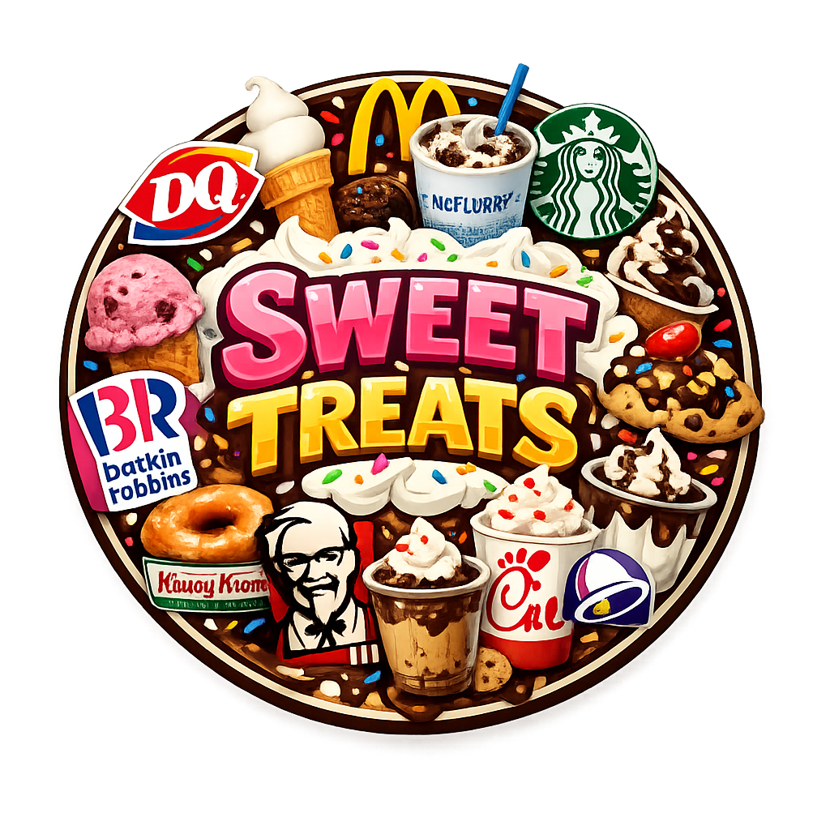

Competitive landscape
Modern
Affordable
Expensive
Traditional

Slide 12
04
Buyer personas

Slide 13

Job title | University Student
Location | Major EU city
Order occasion | Late-night study
Target | 16-25
Acquisition channels | TikTok, Instagram, Deliveroo/Uber Eats
Julia
Low
Delivery app usage
High
Low
Late Night Frequency
High
Low
Loyalty potential
High

Slide 14

Job title | Young professional
Location | Tier-1 EU city
Order occasion | After-work treat / Netflix night
Target | 25-35
Acquisition channels | Instagram, Google Maps, Deliveroo/Uber Eats
Jannette
Low
Delivery app usage
High
Low
Late Night Frequency
High
Low
Loyalty potential
High

Slide 15

Job title | Bar tender
Location | Tier-1 EU city
Order occasion | After-work treat / Netflix night
Target | 25-35
Acquisition channels | Instagram, Google Maps, Deliveroo/Uber Eats
James
Introverted
Delivery app usage
Extroverted
Low
Late Night Frequency
High
Low
Loyalty potential
High

Slide 16
05
Acquisition channels

Slide 17
Now vs. Post-launch
Acquisition now (pilot phase)
Acquisition post-launch (scale phase)
Build loyalty into the product
Launch a loyalty program (points + bundles) to increase repeat purchases and retention.
Scale through referrals
Introduce “Give €5, get €5” and group-order incentives to drive word-of-mouth growth.
Expand with partnerships
Partner with universities, events, and corporate gifting to acquire high-frequency customers at lower CAC.

Slide 18
06
Pricing

Slide 19
Pricing model
01
02
03
Entry pricing
Core bundles
Student deal bundle
€2.5–€3.5 per cookie Why?
Low entry price to drive trial and impulse purchases (late-night cravings).
€14–€18 for 6 cookies (bundle) Why? Bundles increase average order value and fit group/late-night consumption.
€9.99 “Study Pack” (4 cookies + drink)Why? Drives high-volume adoption in university areas

Slide 20
Financial projection
Projected EU revenue growth driven by phased store rollout and delivery penetration.

Slide 21
07
Timeline

Slide 22
Marketing plan
Cookies offer
PR + local media push
PR campaign
Limited edition flavors drop
Campus + nightlife partnerships
Teaser campaign
Social media campaign
TikTok + Instagram campaign
Loyalty program rollout
Holiday gifting campaign
January
April
October
November
December

Slide 23
Thank you
January 2026

